Slide 1
Health Awareness and Nutrition
Eating Disorders
Department of Clinical Nutrition and Dietetics
College of Health Sciences

Slide 2
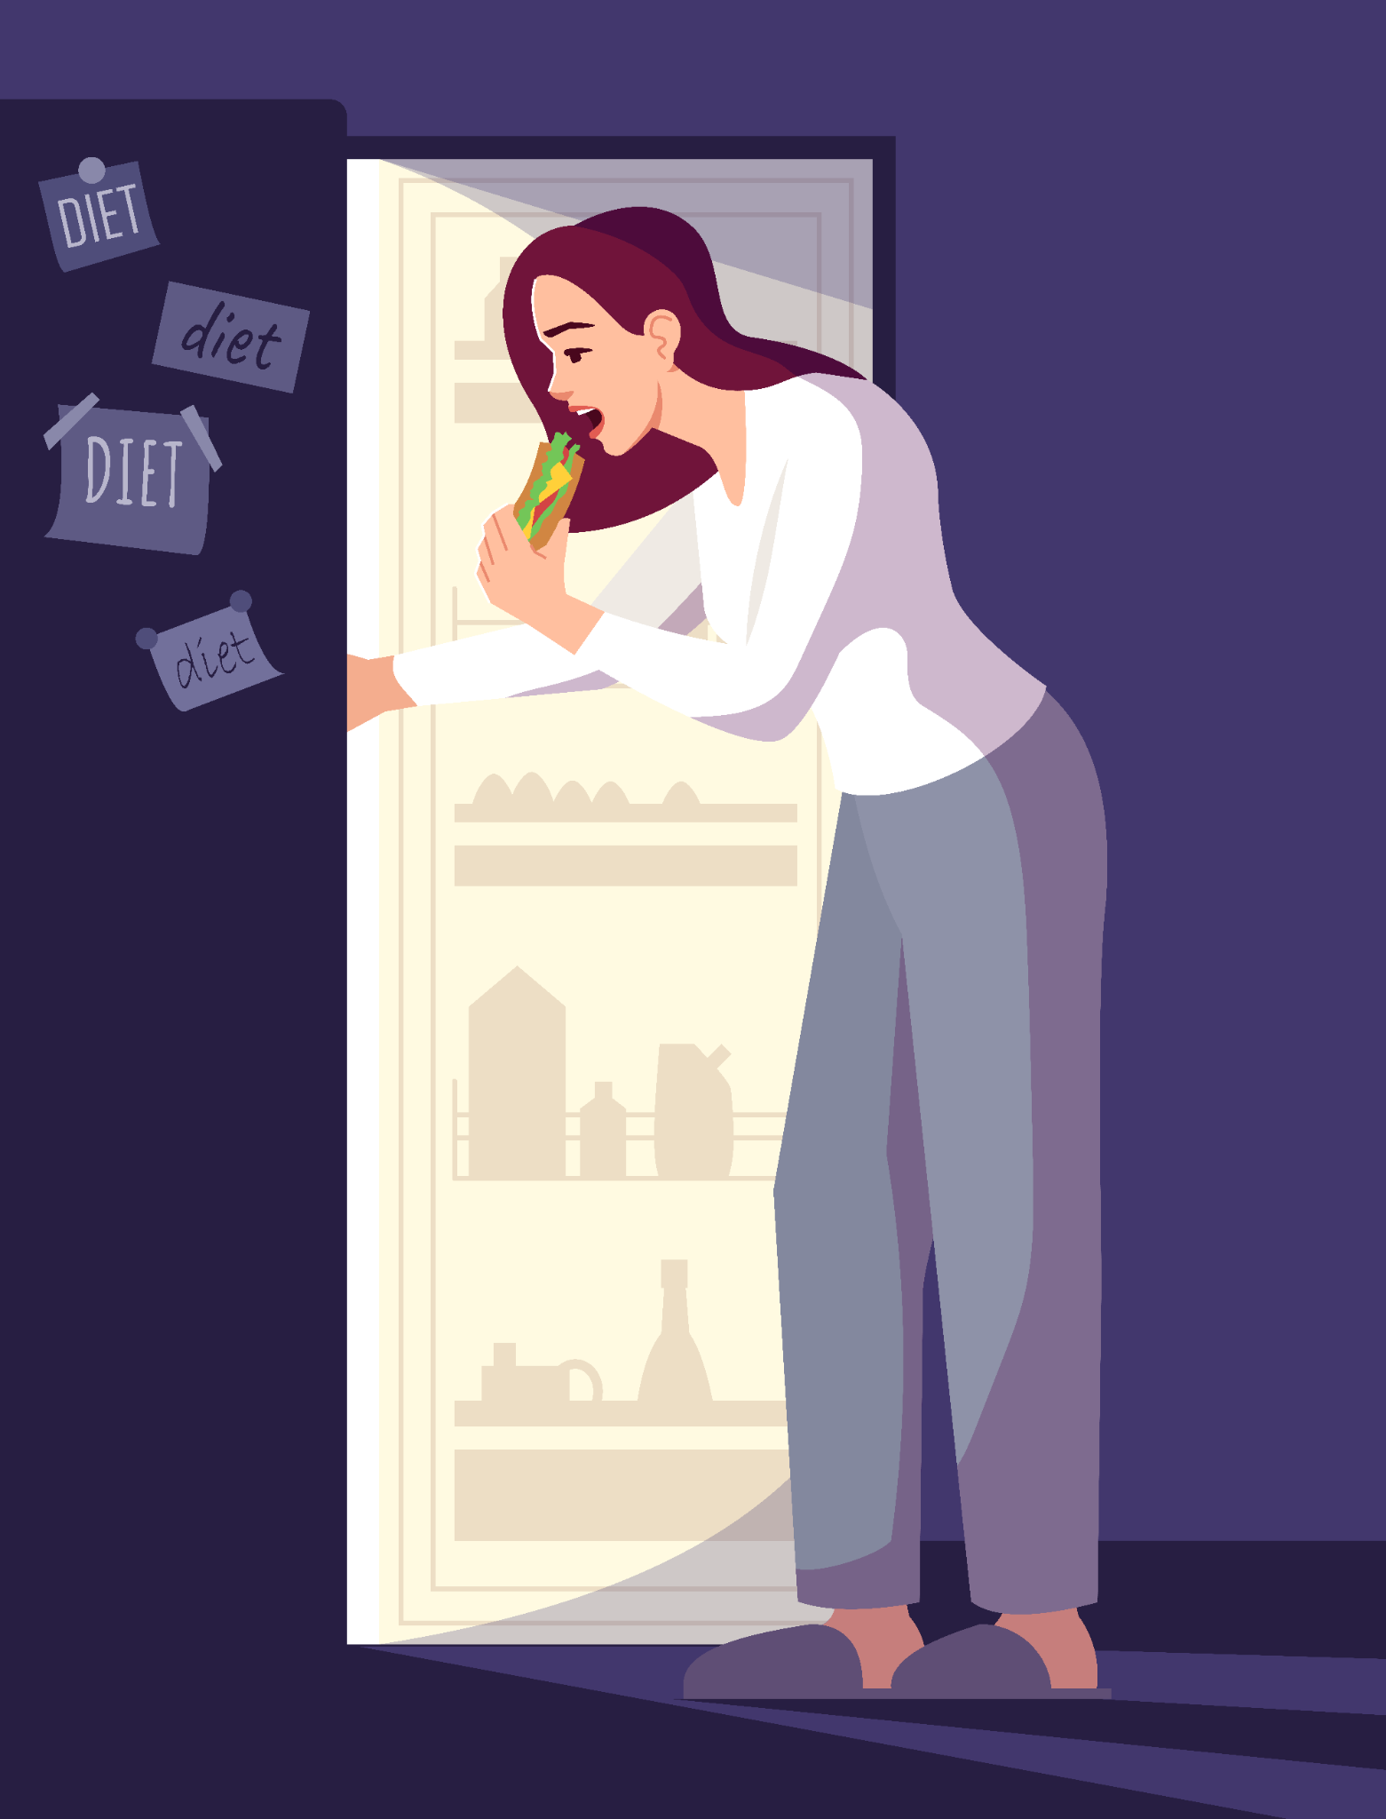
Introduction
What are eating disorders?
An eating disorder is marked by extremes.
It is present when a person experiences severe disturbances in eating behavior.
Three main symptoms:
Abnormal eating (extreme restriction of food intake or recurrent episodes of extreme overeating)
Fear of gaining weight
Body shape distortion (dysmorphia)

Slide 3
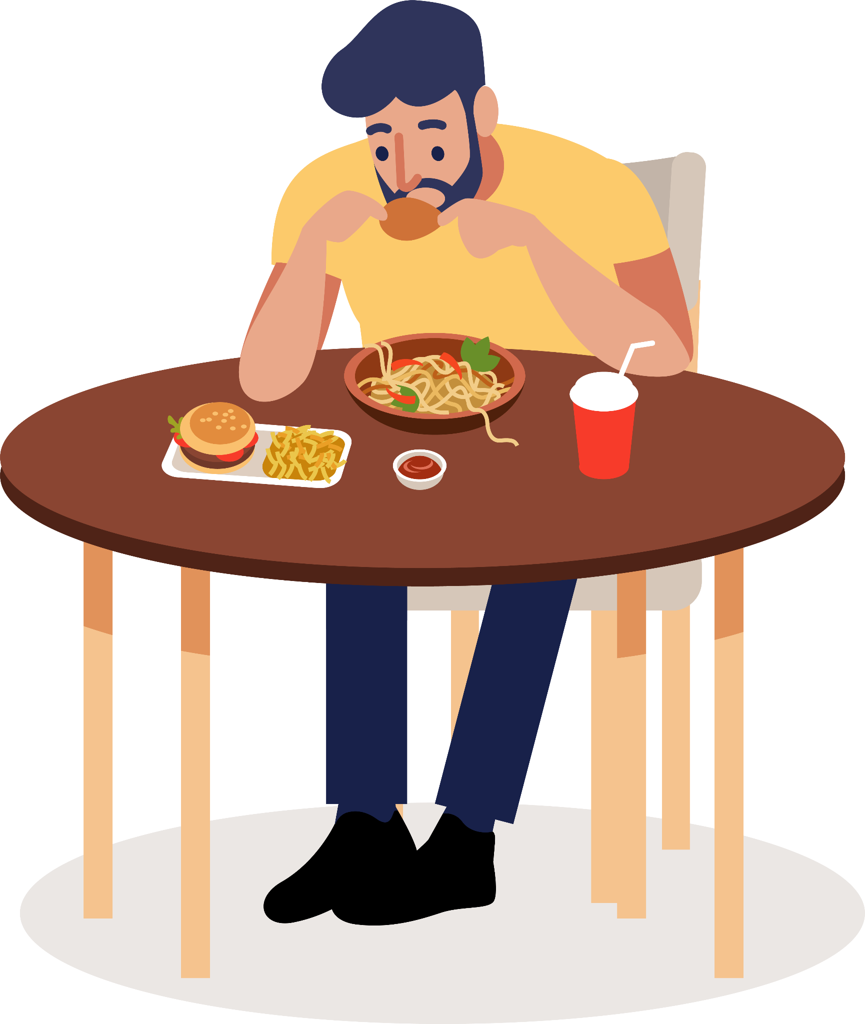
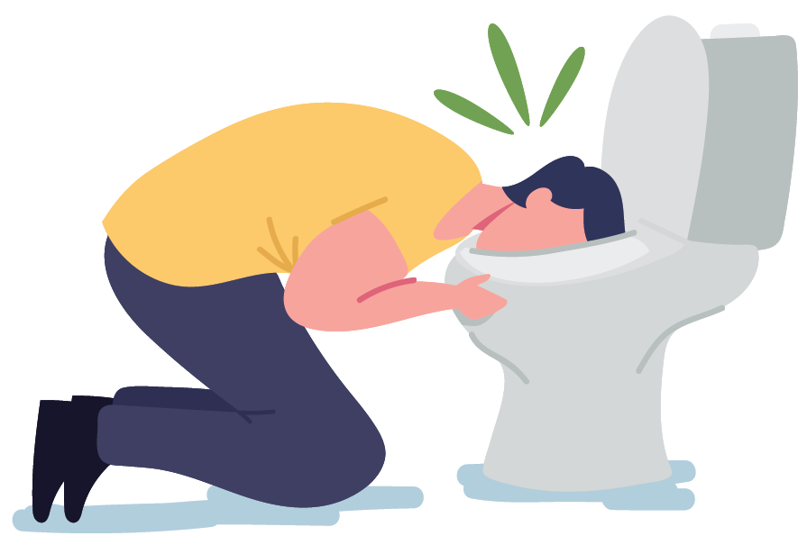
Eating Disorders
Examples of eating disorders that might result in low weight:
Anorexia Nervosa
Bulimia Nervosa
Binge Eating
Pica

Slide 4
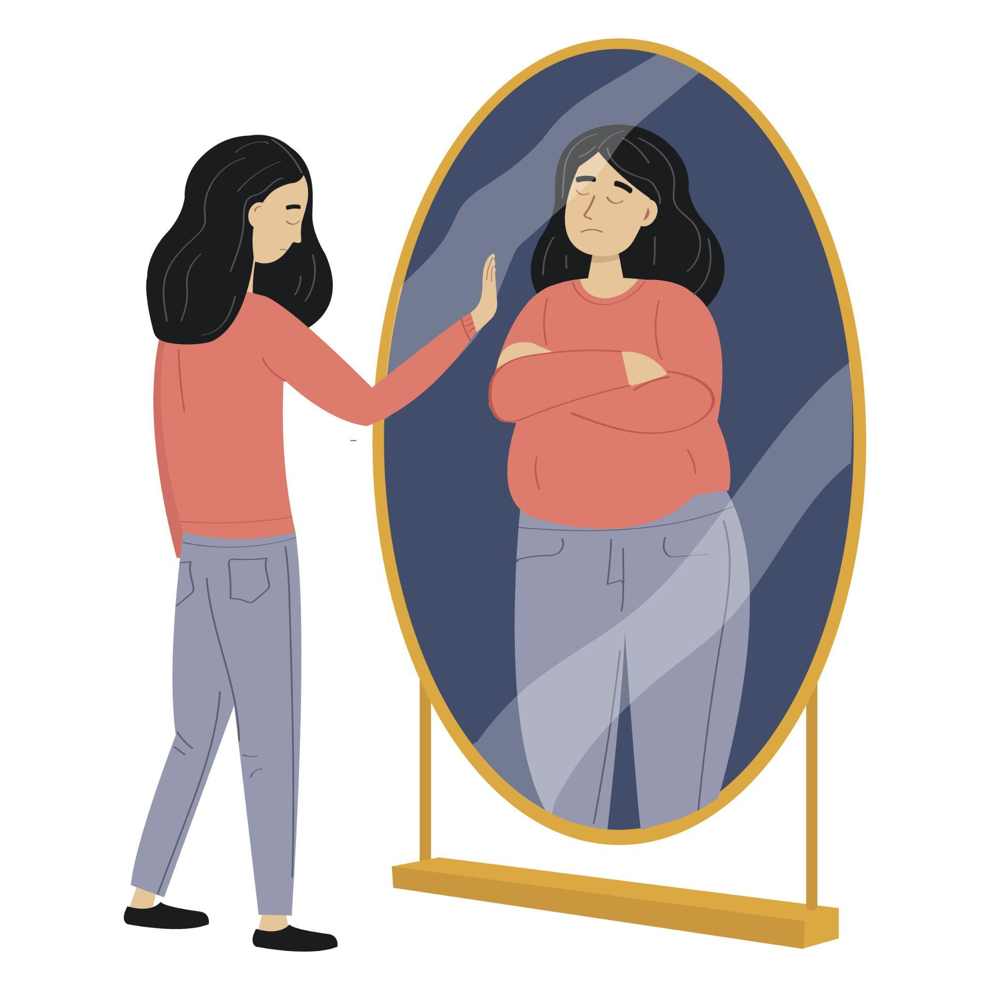
Eating Disorders
Mainly affects young women and dieters.
Research shows: More than 90 percent of those who have eating disorders are women between the ages of 12 and 25 years.
Many men are also affected.

Slide 5
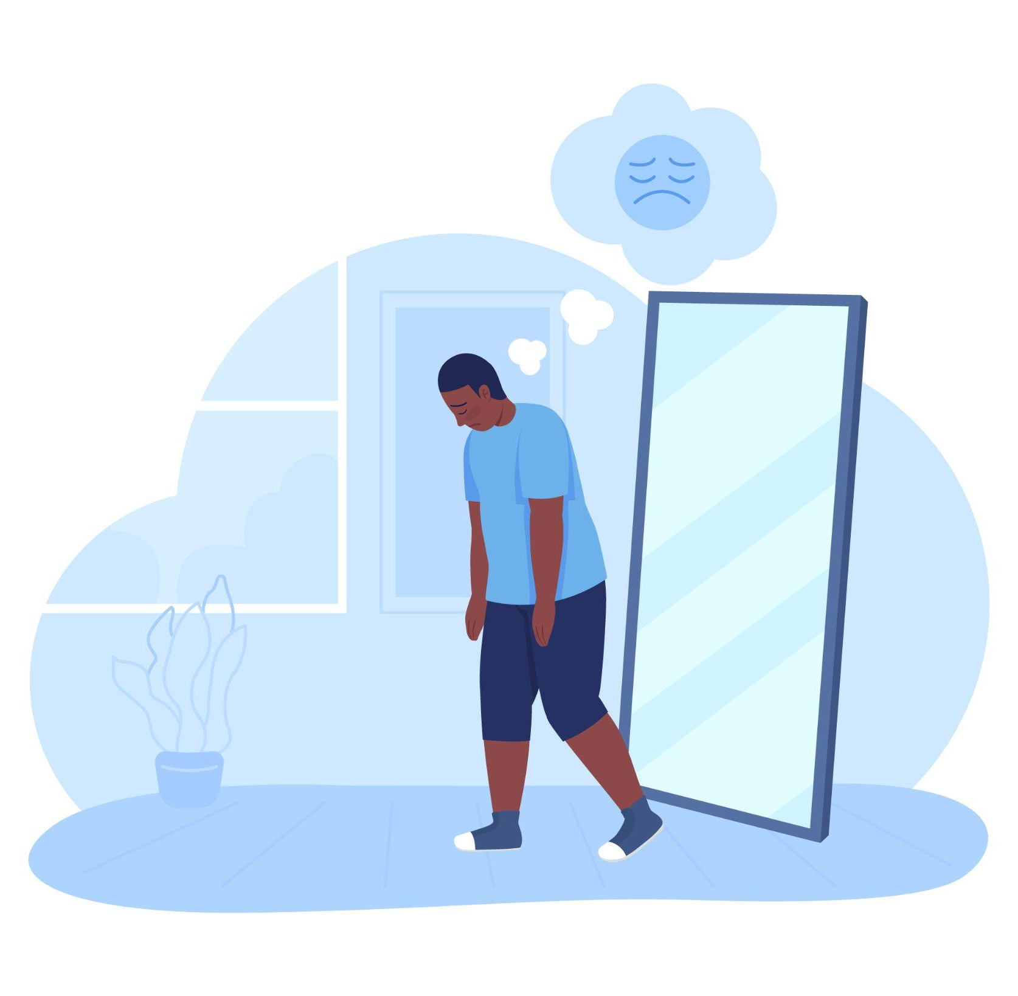
Eating Disorders
Causes:
It often starts with mild obesity; dieting leads to intentional weight loss
The person continues to diet and their body image becomes distorted
Many causes of eating disorders are related to societal pressure for thinness
Treatment:
Psychotherapy (psychological counseling)
Medication
Nutritional support for achieving & maintaining desirable body weight

Slide 6
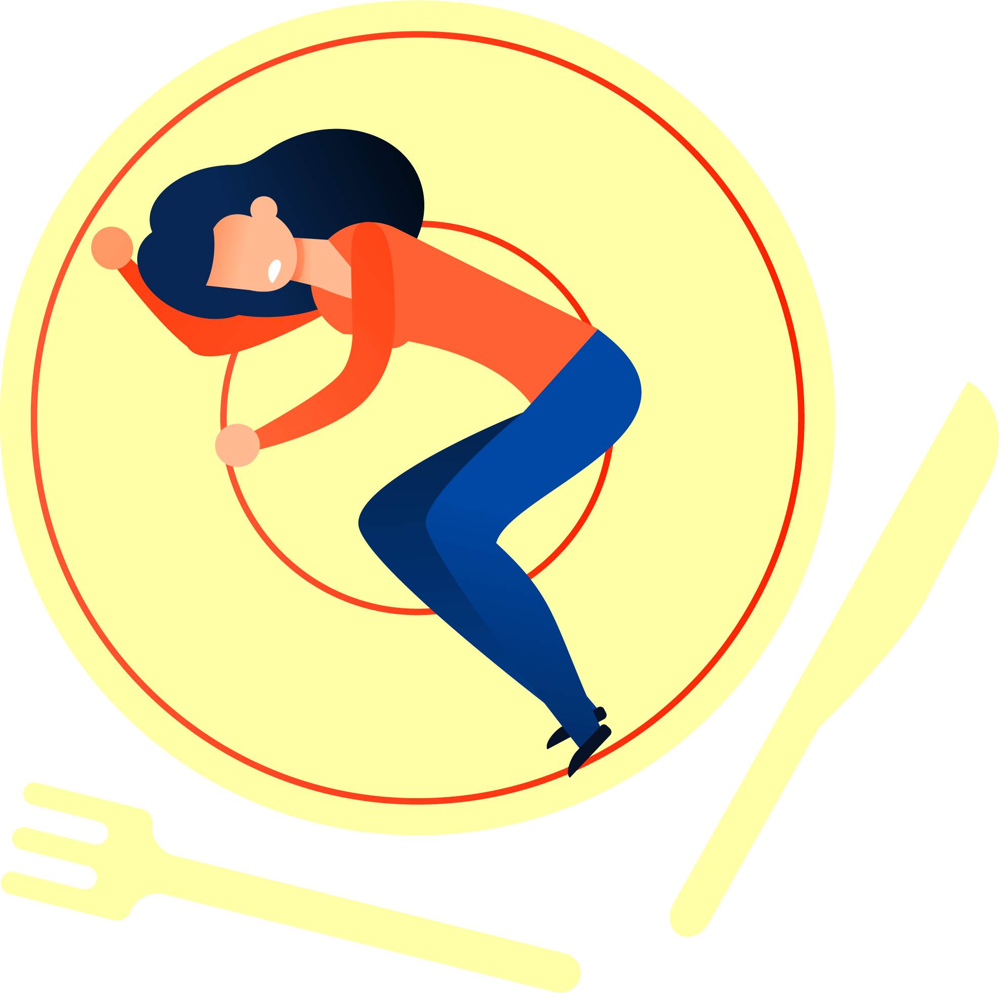
Eating Disorders
Red flags for eating disorders include:
Menstrual irregularities
Fertility problems
Unexplained seizures
Chronic fatigue
Calluses on hands
Loss of dental enamel

Slide 7
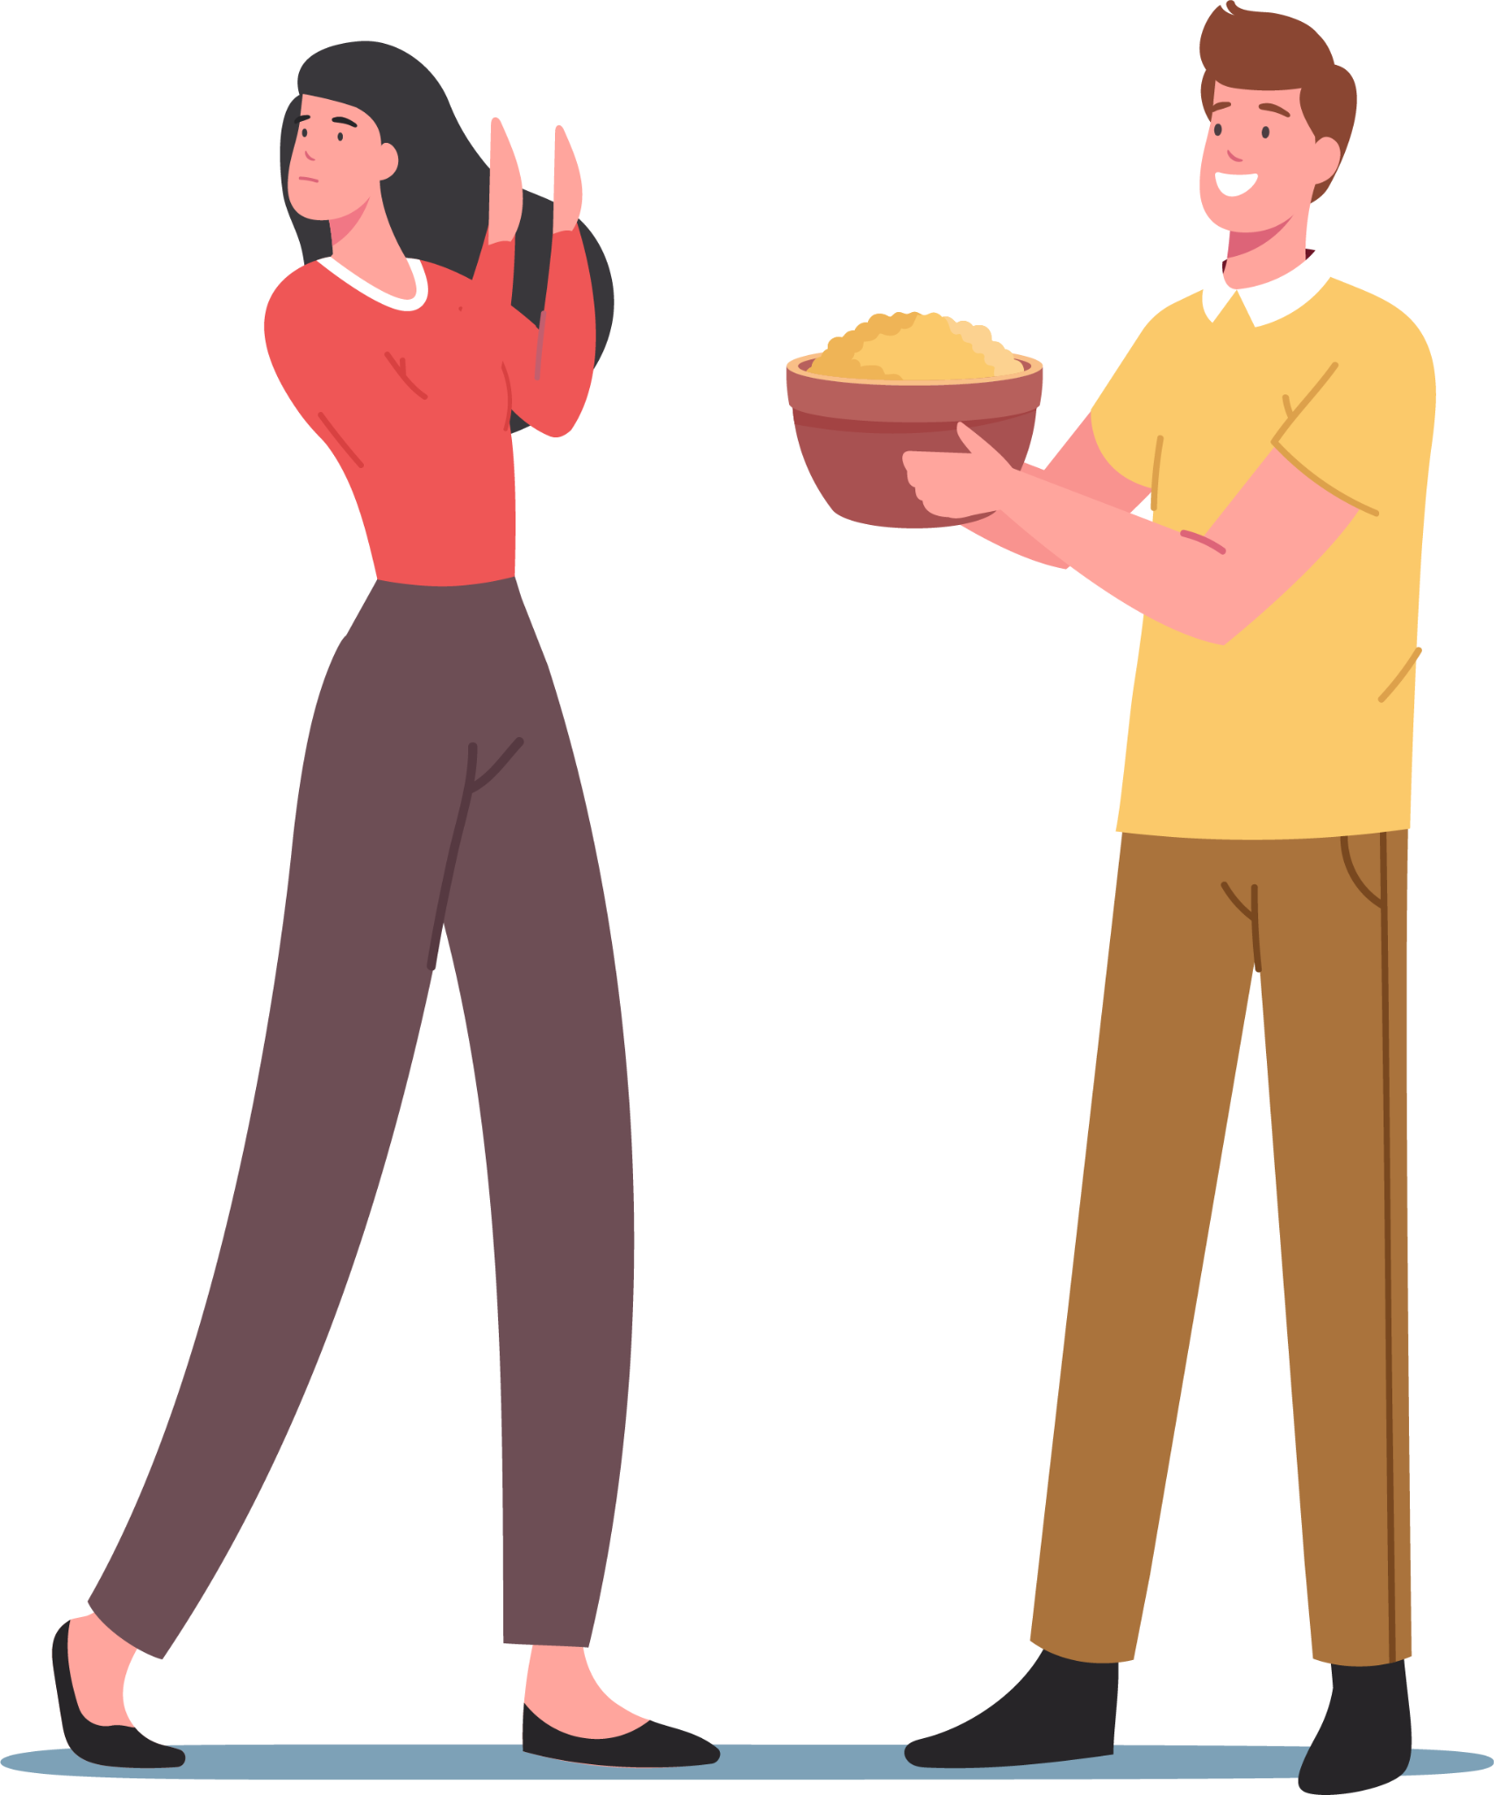
Anorexia Nervosa
Anorexia is also called self starvation:
A person with anorexia nervosa will experience significant weight loss due to a combination of food restriction, starvation, and an intense fear of gaining weight.
Anorexia nervosa usually develops during adolescence or early adulthood.
Anorexia is an attempt to use food to deal with emotional problems.
Due to the fear of gaining weight, people restrict the amount of food they consume.
Lower food intake causes metabolic and hormonal disorders.

Slide 8
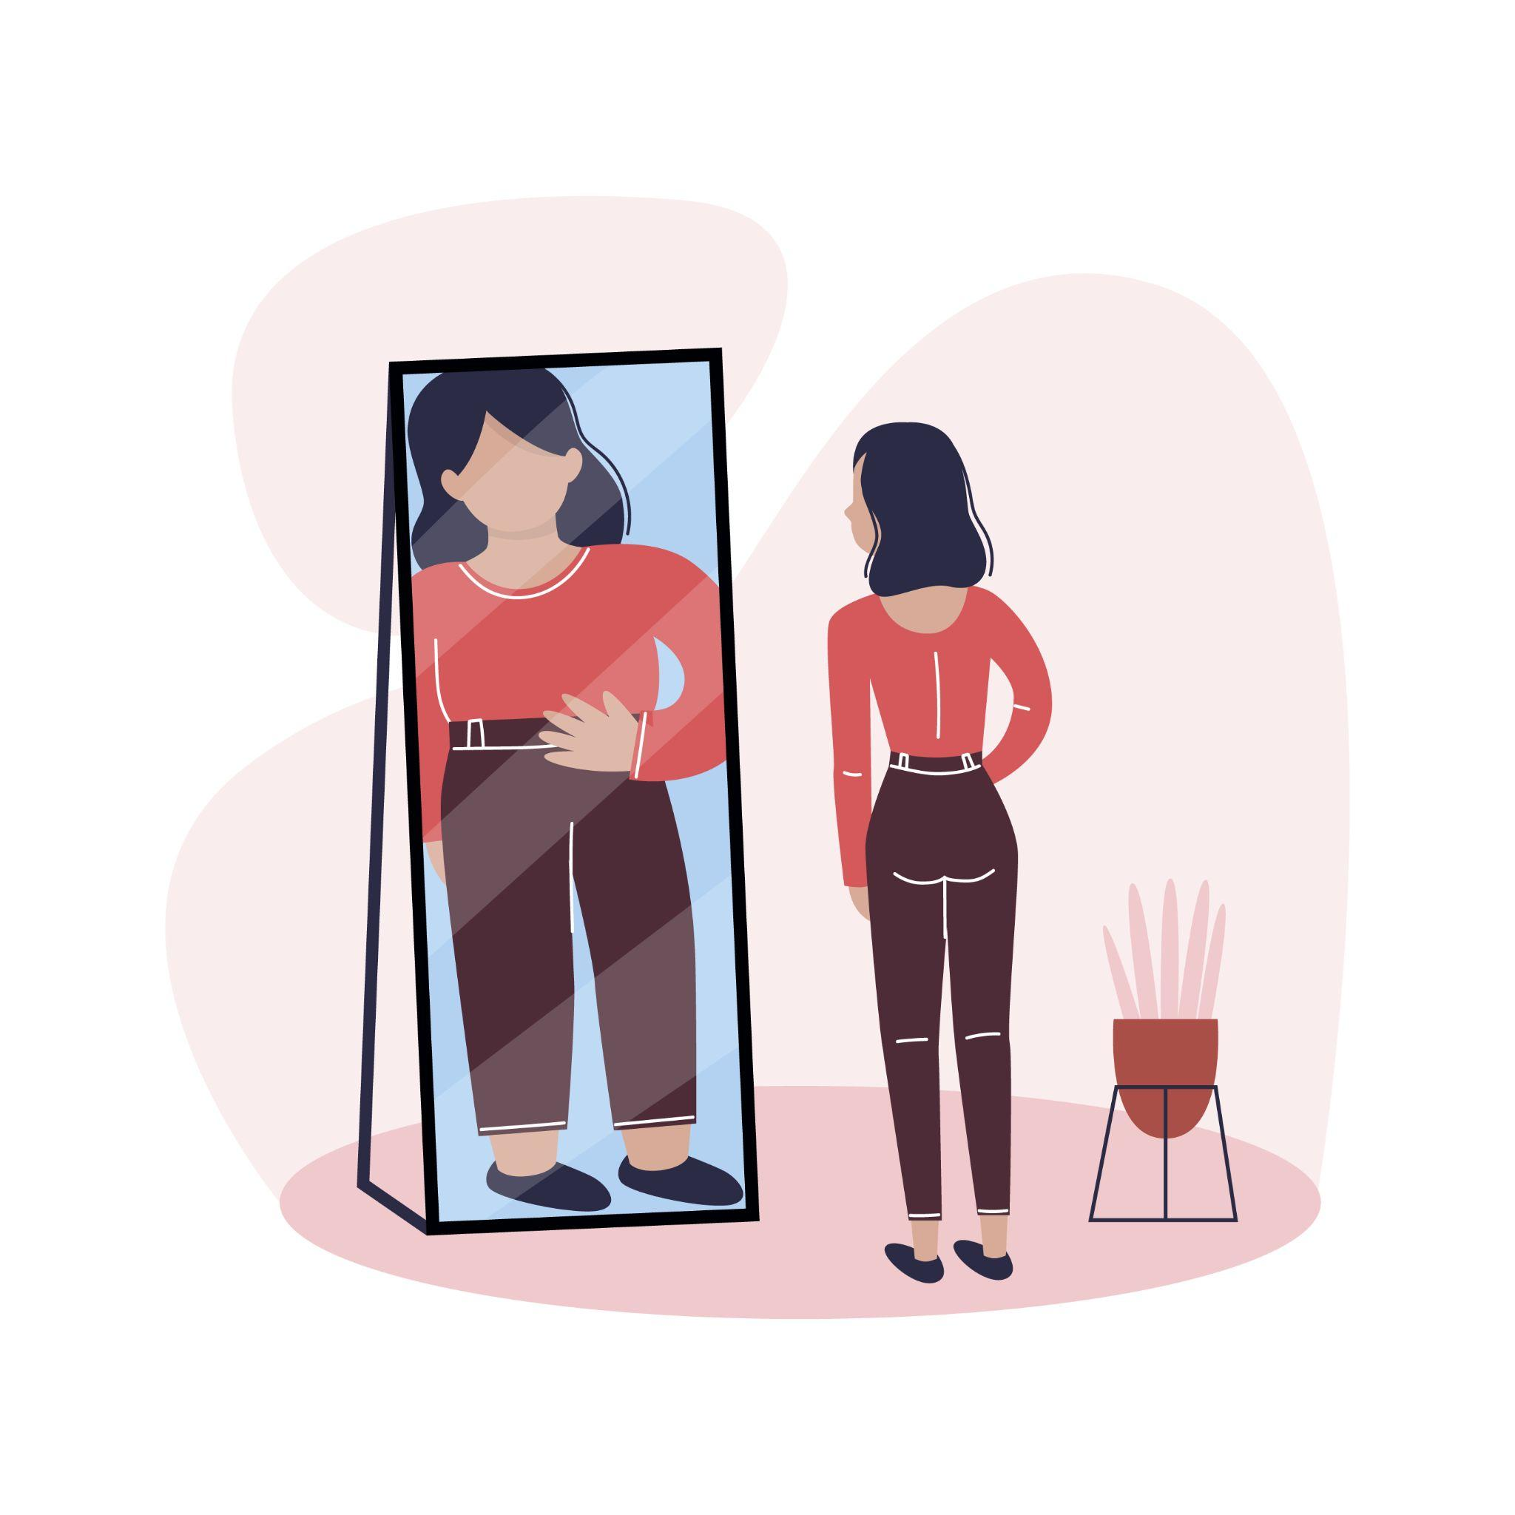
Anorexia Nervosa
It is characterized by:
Excessive and irrational food restriction
Fear of becoming obese with a distorted body-image and a distorted body self-perception
Starvation and food avoidance
A BMI of 17.5 or less

Slide 9
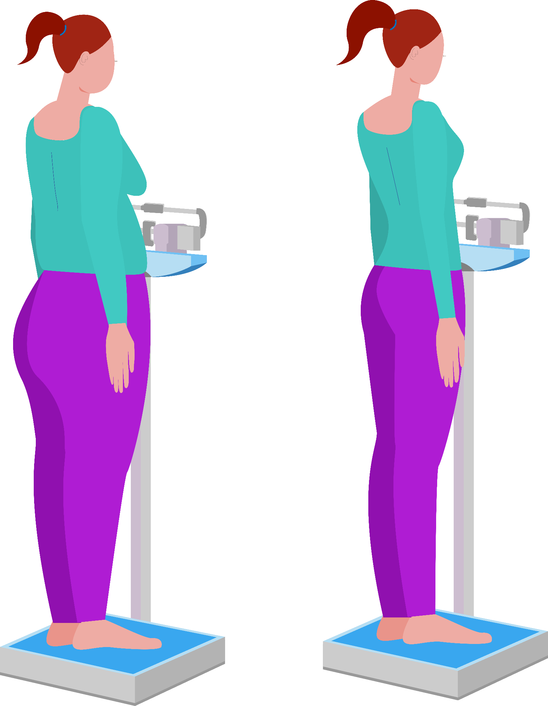
Anorexia Nervosa
Symptoms:
Severely malnourished and underweight
Preoccupation with eating, food, body shape or weight
Obsession with calories and fat content of food
Difficulty concentrating
Refusal to maintain a normal BMI for their age
Intolerance to cold
Hair loss or thinning
Fatigue

Slide 10
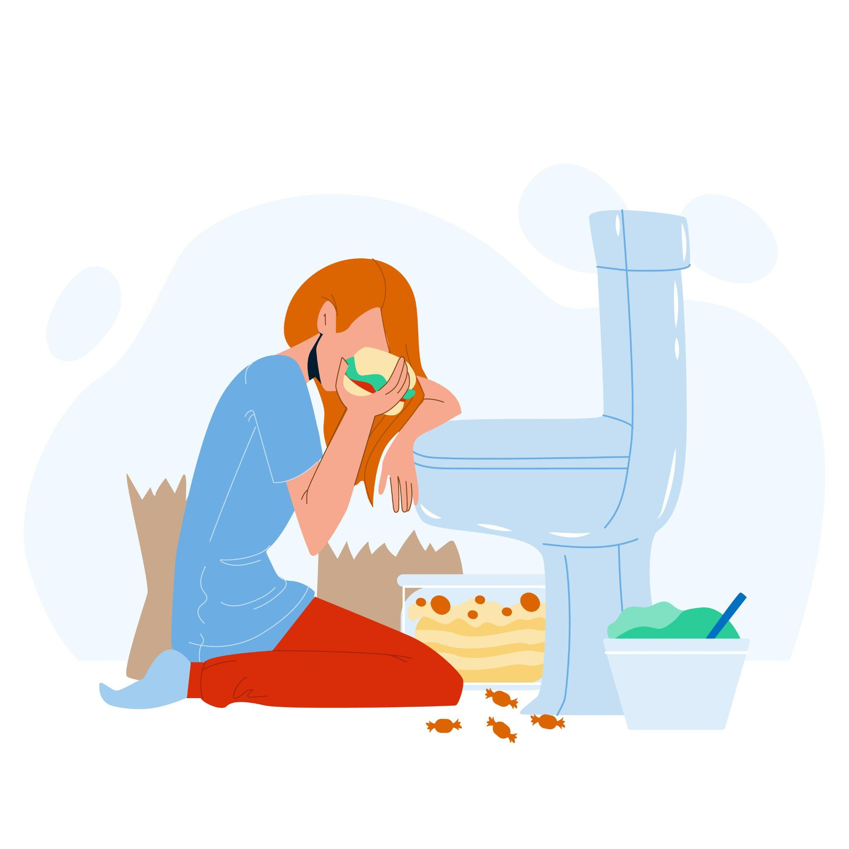
Bulimia Nervosa
Characterized by episodes of binge eating and purging (vomiting, laxatives, fasting, medications and diuretics).
Binge eating:
Eating huge quantities of food in a short time
Feeling of loss of control over eating
Purging:
Compensation mechanism
Repeatedly compensates for binging by purging (vomiting), taking laxatives, enemas, and/or dieting
Extreme exercise to stay thin

Slide 11
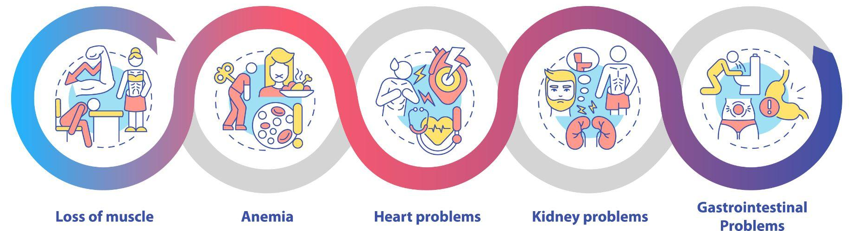
Complications
Complications of Anorexia and Bulimia:
Osteoporosis
Anemia
Menstrual irregularities
Erosion of digestive tract and teeth and sore throat due to forced vomiting (among bulimic patients)
Electrolyte imbalance
Gastrointestinal problems
Dry skin/hair
Anxiety/Depression
Slow heart rate
Low blood pressure
Death

Slide 12
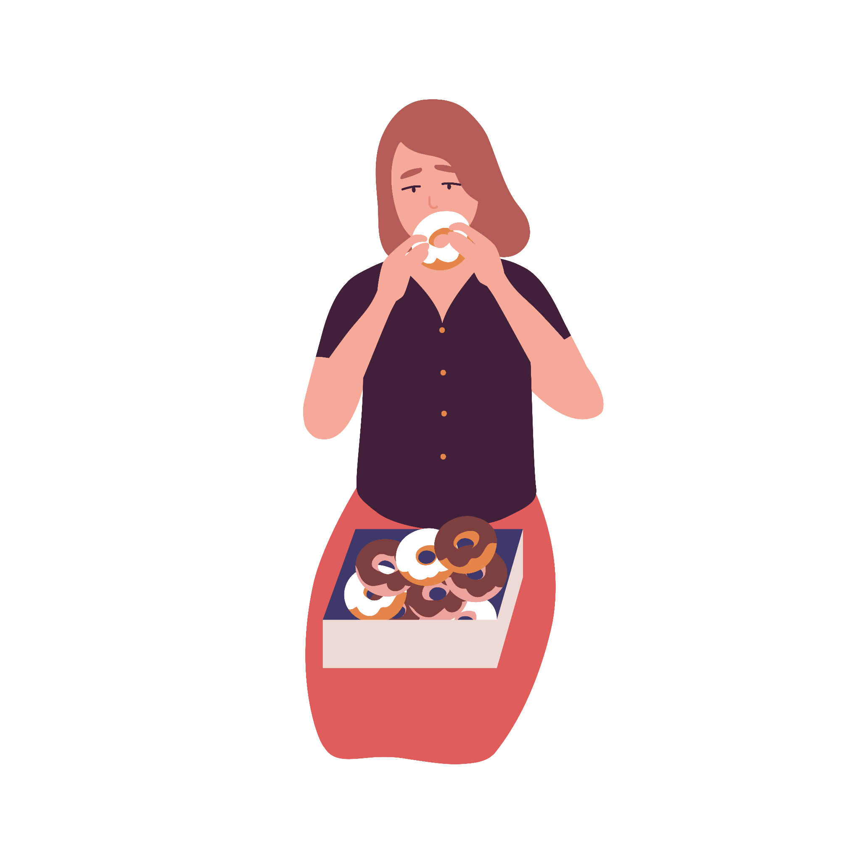
Binge Eating
Binge eating begins during or after strict dieting.
A person eats a large amount of food in a shorter period of time than normal people.
The person also feels a sense of loss of control.
It may be caused by stress.

Slide 13
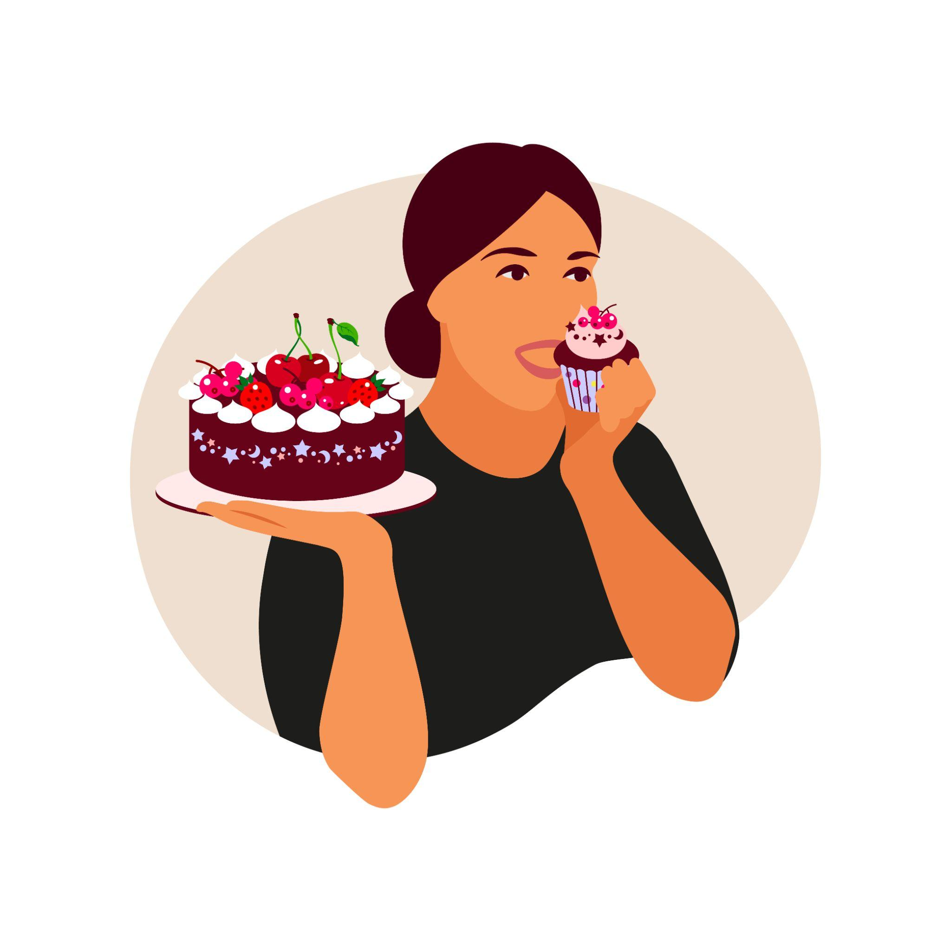
Binge Eating
Binge eating Is characterized by recurrent eating without purging:
Eat rapidly
Uncomfortably full
Eating when not hungry
Eating alone
Feeling disgusted or guilty after binging
Feelings of shame related to food or weight

Slide 14
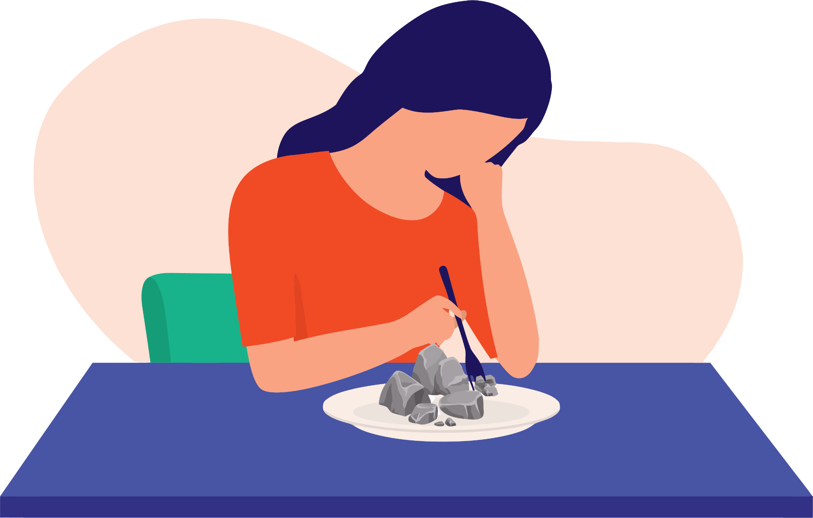
Pica
It is a pattern of eating non-food materials (such as dirt or paper) or craving for non-food items.
This pattern of eating should last at least 1 month to fit the diagnosis of pica.
People with pica may eat:
Dirt, paint, clay, plaster, chalk, rocks, cigarettes, ashes, sand, starch, rust, hair, baking soda, glue, ice, etc.

Slide 15
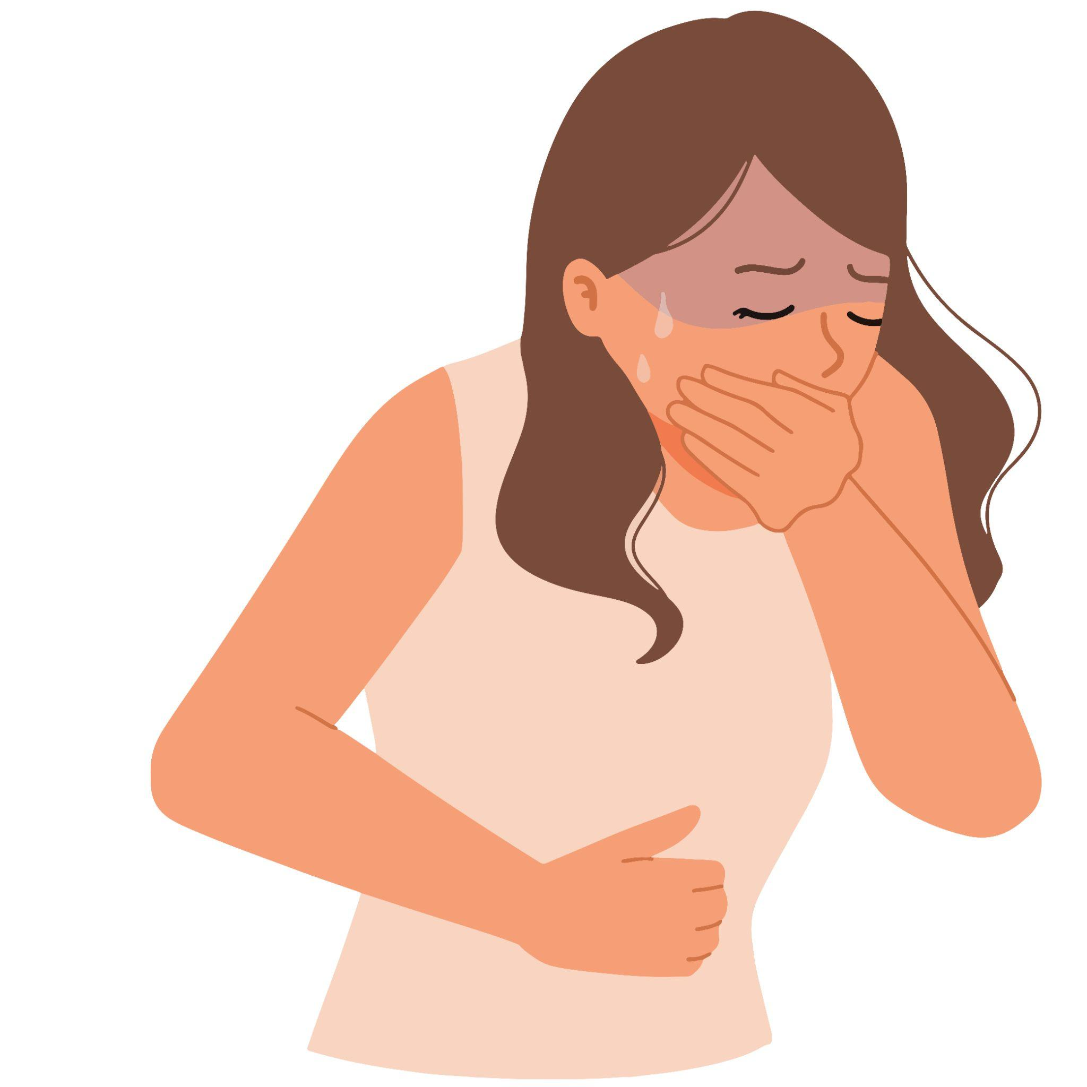
Pica
Causes:
It is observed more in young children than adults
It can occur during pregnancy due to lack of certain nutrients
Pica may also occur in adults who crave a certain texture in their mouth
Complications:
Malnutrition
Intestinal obstruction and infection
Anemia
Mercury/lead poisoning
Liver and kidney damage
Constipation and abdominal problems

Slide 16
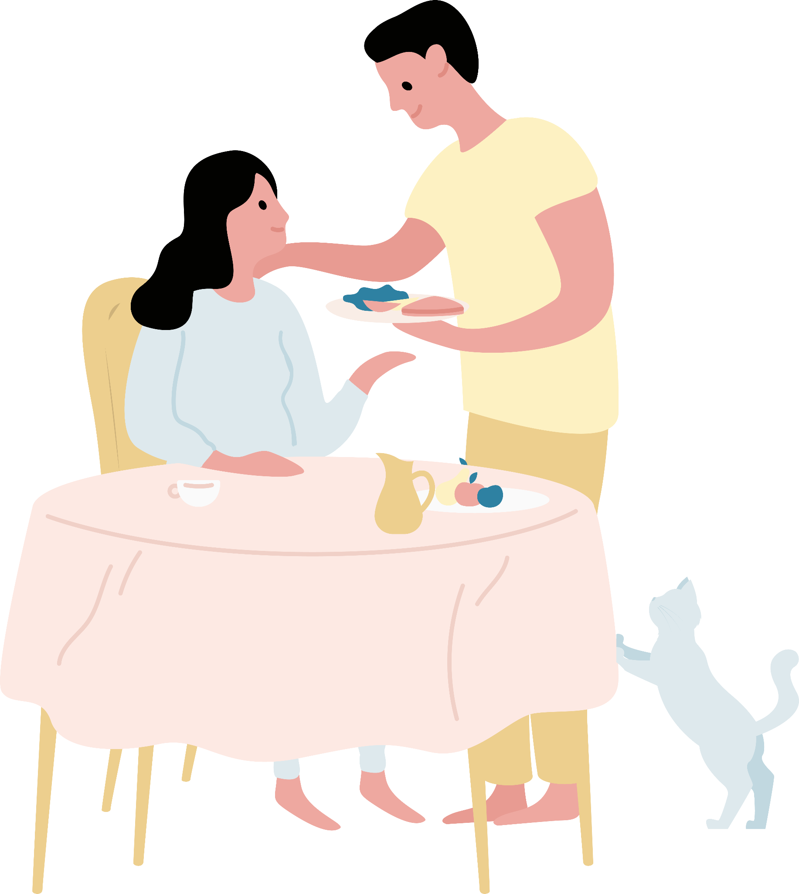
Key Recommendations
Aim to achieve and maintain a healthy body weight.
Consume a balanced diet.
Avoid fad diets and “quick fix’” solutions.
Avoid making negative or shaming comments about food and eating.
Avoid talking about weight at home. Focus instead on having a healthy lifestyle.

Slide 17
Key Recommendations
Maintain a positive body image.
Accept yourself as you are.
Focus on the things you like about yourself.
Maintain a healthy body by eating an appropriate amount of food and getting enough exercise.
Spend time with people who like you and appreciate you for yourself.
Show that you value yourself by taking good care of your body and mind.

